Slide 1
Concentration and Focus
VEV 741 Session 3 – Goal Setting and Continuous Improvement

Slide 2
A quick recap
So far we looked at
Different concentration techniques practiced by high achievers
Had an opportunity to start a journal and to do a mindfulness survey
Simple ways to practice concentration
If you need any clarity on these please contact Dushyant or me later.

Slide 3
Sessions 3 and 4
Understanding your potential and the mental barriers that limit you
Understanding your personality type
Identifying a long term goal
Continuous Improvement – Kaizen

Slide 4
Achievement vs Potential
Notes:
Get high achievers slide copied here

Slide 5
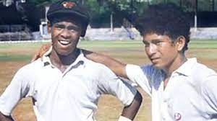
Talent vs Focus
Sachin and Vinod started at the same time at school
They played together in a Harris shield match and scored unbeaten 664 runs
Vinod also took wickets in the match
Experts said that Vinod has more talent than Sachin
But what actually happened?

Slide 6
What prevents us from reaching our full potential?
Self Doubt and limiting beliefs (Lack of atmashraddha)
Fear of failure (Fear)
Laziness & delayed action (Tamas)
Unaware of our own potential (Ignorance)
Lack of a purpose in life (Tamas + Ignorance)
Ego leading to disharmonious relationships ( Rajas)
What else?

Slide 7
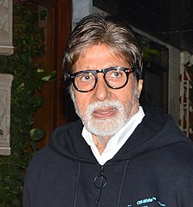
Amitabh Bachchan – Overcoming Deficiencies
"Sometimes we are tested not to show our weakness, but to show our strength."
कभी कभार , हमारा इम्तिहान , हमारी कमज़ोरियों को दिखाने के लिए नहीं लिया जाता ; वो लिया जाता है , हमारी ताक़त को दिखाने के लिए

Slide 8
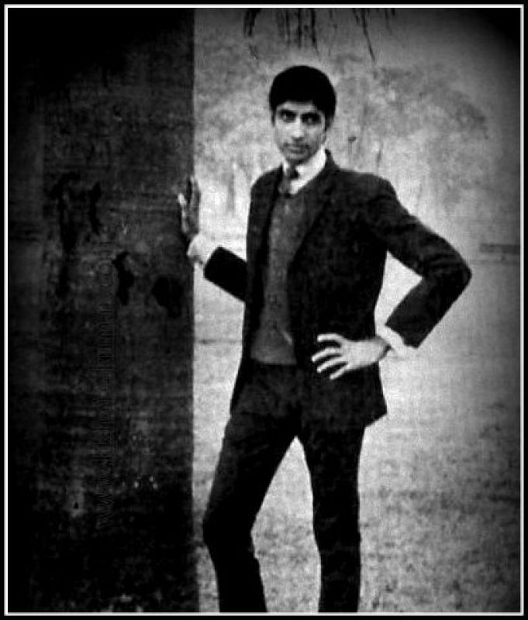
Early days of career… Late 60s to early 70s
Rejected
Too tall!
Too lean
Baritone voice
Not hero material!!
First 13 movies were a flop!!
I had come away from home to seek the possibilities of joining the Industry in some other way. But one look at Rajesh Khanna made me realize that with people like him around, there would be little chance or opportunity for me, in this new profession!

Slide 9
Later …..
From flop star to Super star!
Labelled as “Angry young man”
Redefined the definition of hero in Hindi films
Still later on
Overcame a near death experience
Became bankrupt – ABCL corporation
Failed in Politics
Rose again through Kaun Banega Crorepati
And is still going strong
Notes:
40 minutes

Slide 10
Group work
Each member of a group will
Identify one deficiency based on personal experience that prevent you from achieving your potential.
The group will then choose any 1 deficiency and work out a strategy to convert this deficiency into strength
Make a presentation before the group – only 5 minutes per group
Notes:
30 minutes plus 30 minutes

Slide 11
Shadripus – 6 enemies of the mind
Krodh - anger
Kaam - desire
Lobh - greed
Madh - pride
Moh - delusion/attachment to harmful people/things
Maatsarya – jealousy
Notes:
Conculsion 20 minutes

Slide 12
To contact me
anu.vfaculty@iitd.ac.in
WhatsApp 9811164667

